Slide 1

ME 594 – Numerical Methods
Fall 2022
Comparing Curve fitting techniques for an IMU sensor Data
Presentation by,
Viral Panchal
Stevens Institute of Technology

Slide 2
Overview
Introduction
Numerical methods
Least squares
Cubic splines
Results
Output plots
Computation time
Conclusion
Stevens Institute of Technology

Slide 3
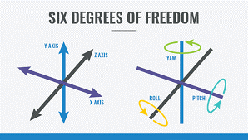
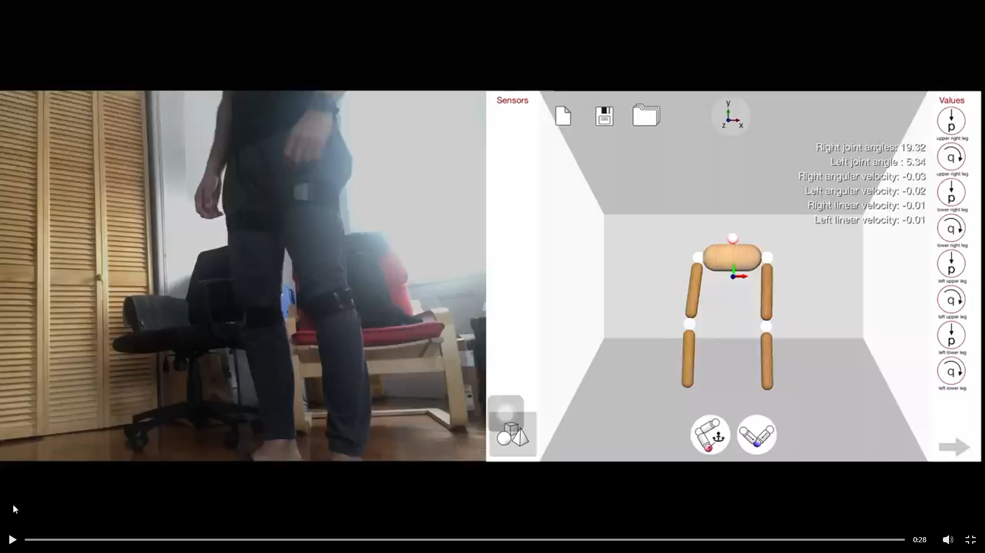
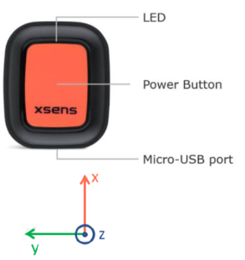
Introduction
Inertial measurement unit
Used to measure acceleration, angular velocity, and magnetic fields.
Using sensor fusion, these data can be used to determine the motion, orientation, and heading angle of the system.
Stevens Institute of Technology

Slide 4
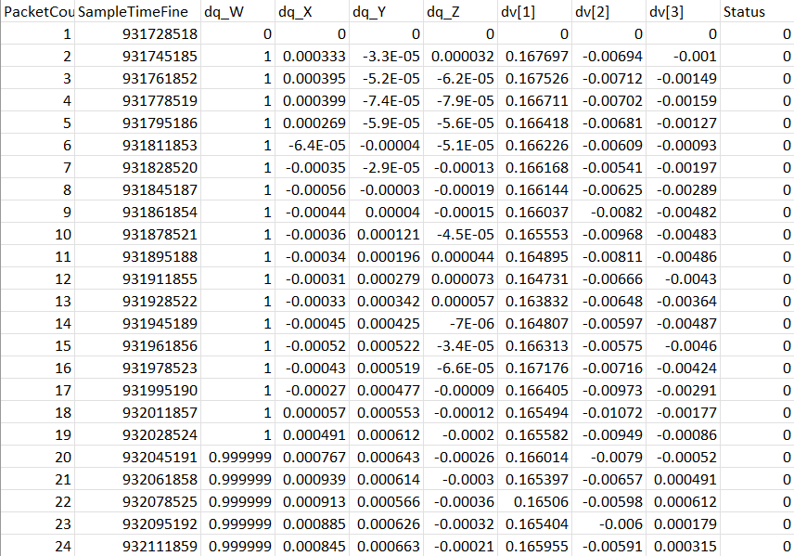
Introduction
Testing data
741 samples
~ 12 second testing reading
Stevens Institute of Technology

Slide 5

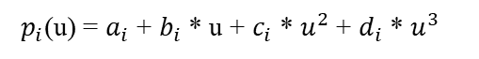
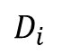
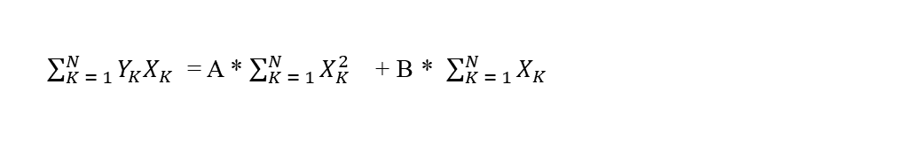
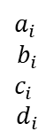
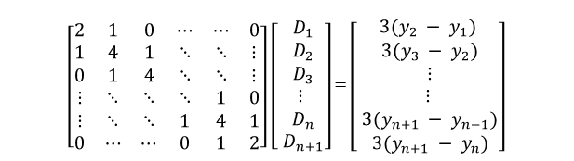
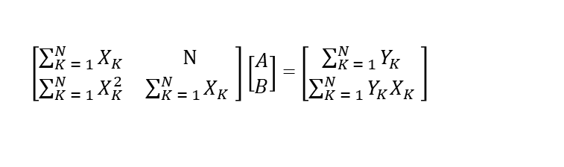
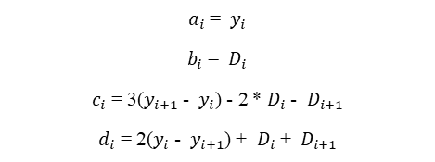
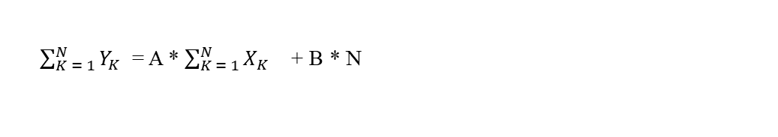
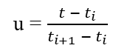
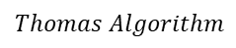
Numerical methods
Concept
Least Squares
Cubic Splines
Y= A * X+ B
$p_{i}$(u) = $a_{i}$ + $b_{i}$ * u + $c_{i}$ * $u^{2}$ + $d_{i}$ * $u^{3}$
$\sum_{K = 1}^{N}{Y_{K}}$ = A * $\sum_{K = 1}^{N}{X_{K}}$ + B * N
u = $\frac{t − t_{i}}{t_{i+1} − t_{i}}$
y = A x+ B
y = A x²+ Bx + C
$\sum_{K = 1}^{N}{Y_{K}X_{K}}$ = A * $\sum_{K = 1}^{N}{X_{K}^{2}}$ + B * $\sum_{K = 1}^{N}{X_{K}}$
y = A x³+ Bx² + Cx + D
$a_{i}$ = $y_{i}$
$b_{i}$ = $D_{i}$
$c_{i}$ = 3($y_{i+1}$ - $y_{i}$) - 2 * $D_{i}$ - $D_{i+1}$
$d_{i}$ = 2($y_{i}$ - $y_{i+1}$) + $D_{i}$ + $D_{i+1}$
$\left[\begin{matrix}2 & 1 & 0 & ⋯ & ⋯ & 0 \\ 1 & 4 & 1 & ⋱ & ⋱ & ⋮ \\ 0 & 1 & 4 & ⋱ & ⋱ & ⋮ \\ ⋮ & ⋱ & ⋱ & ⋱ & 1 & 0 \\ ⋮ & ⋱ & ⋱ & 1 & 4 & 1 \\ 0 & ⋯ & ⋯ & 0 & 1 & 2\end{matrix}\right]$ $\left[\begin{matrix} D_{1} \\ D_{2} \\ D_{3} \\ ⋮ \\ D_{n} \\ D_{n+1}\end{matrix}\right]$ = $\left[\begin{matrix}3(y_{2} − y_{1}) \\ 3(y_{3} − y_{2}) \\ ⋮ \\ ⋮ \\ 3(y_{n+1} − y_{n−1}) \\ 3(y_{n+1} − y_{n})\end{matrix}\right]$
$\left[\begin{matrix}\sum_{K = 1}^{N}{X_{K}} & N \\ \sum_{K = 1}^{N}{X_{K}^{2}} & \sum_{K = 1}^{N}{X_{K}} \end{matrix}\right]\left[\begin{matrix}A \\ B\end{matrix}\right]$ = $\left[\begin{matrix}\sum_{K = 1}^{N}{Y_{K}} \\ \sum_{K = 1}^{N}{Y_{K}X_{K}} \end{matrix}\right]$
Order n
A = B =
$a_{i}$
$$b_{i}$$
$c_{i}$
$$d_{i}$$
$Thomas Algorithm$
$D_{i}$
Stevens Institute of Technology

Slide 6
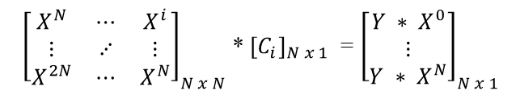
Results
Least Square
Fitting a line equation, y = Ax + B
Y = 9.253e-11 * x + 0.0591
Computation time – 1.1 seconds
${\left[\begin{matrix}X^{N} & ⋯ & X^{i} \\ ⋮ & ⋰ & ⋮ \\ X^{2N} & ⋯ & X^{N}\end{matrix}\right]}_{N x N}$ * ${\left[C_{i}\right]}_{N x 1}$ = ${\left[\begin{matrix}Y ∗ X^{0} \\ ⋮ \\ Y ∗ X^{N}\end{matrix}\right]}_{N x 1}$
Stevens Institute of Technology

Slide 7
Results
Generic Least Square
Termination condition: MSE < Tolerance (1e-6)
Program terminated at order 2
Computation time – 1.2 seconds
Stevens Institute of Technology

Slide 8
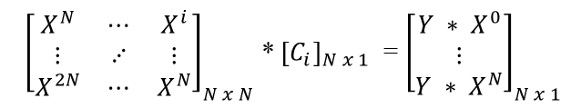
Results
Generic Least Square
Plotting up to order 20 polynomial irrespective of error.
MATLAB not able to compute after order 17.
Computation time – 1.4 seconds
${\left[\begin{matrix}X^{N} & ⋯ & X^{i} \\ ⋮ & ⋰ & ⋮ \\ X^{2N} & ⋯ & X^{N}\end{matrix}\right]}_{N x N}$ * ${\left[C_{i}\right]}_{N x 1}$ = ${\left[\begin{matrix}Y ∗ X^{0} \\ ⋮ \\ Y ∗ X^{N}\end{matrix}\right]}_{N x 1}$
Stevens Institute of Technology

Slide 9
Results
Cubic splines method
Computation time – 1.9 seconds
Stevens Institute of Technology

Slide 10
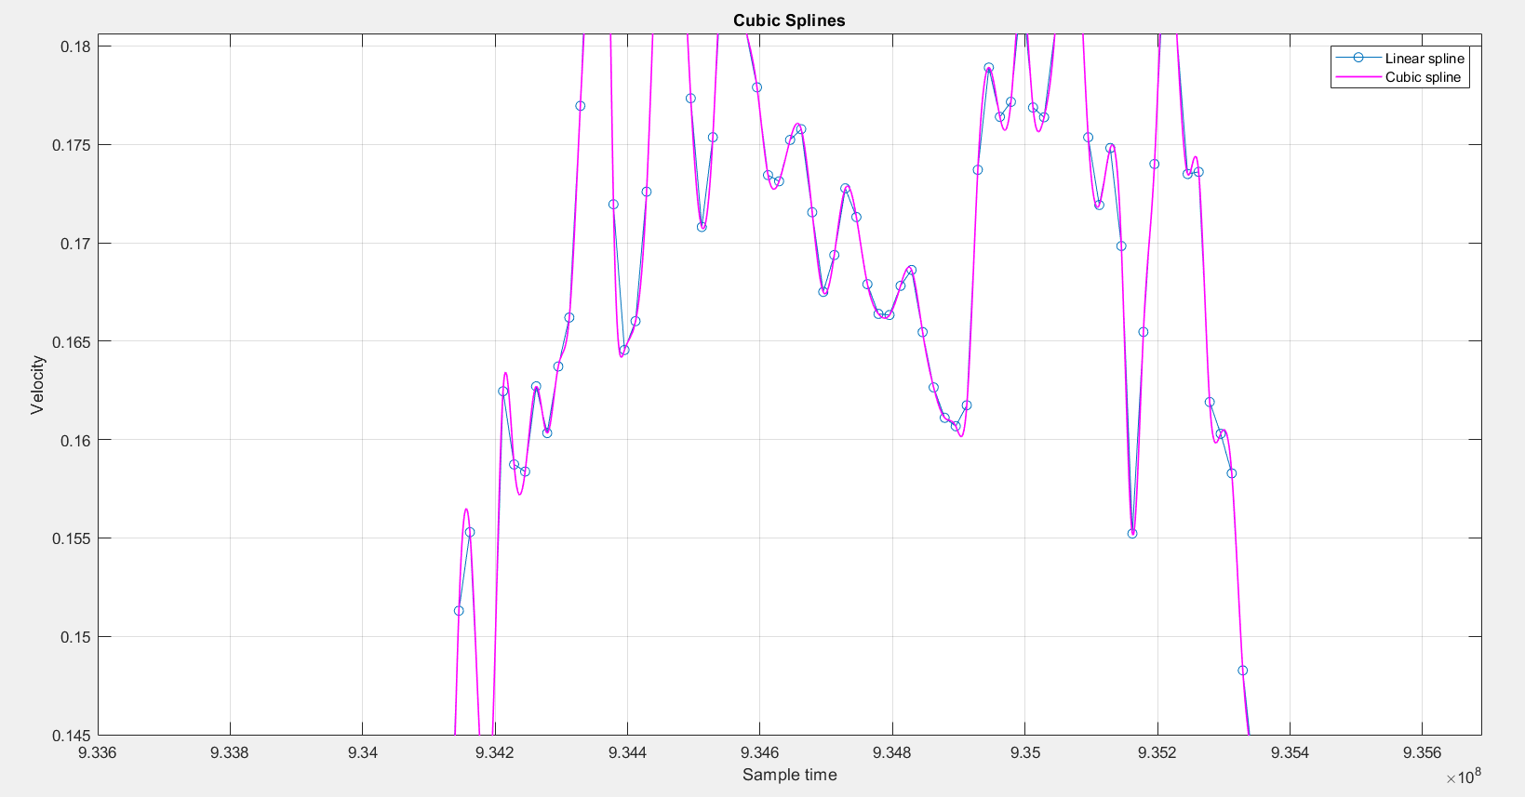
Results
Cubic splines method
Computation time – 1.9 seconds
Stevens Institute of Technology

Slide 11
Conclusion
Least squares
Cubic splines
Easy program
Less time
Resulting plot does not help much to infer any behavior
Useful when the data has one kind of trend, i.e., either increasing or decreasing on a 2D plane.
Little complex program
Computation time still acceptable compared to LS method.
Resulting plot passes through all the data points.
Overall better than the generic LS method.
Stevens Institute of Technology

Slide 12
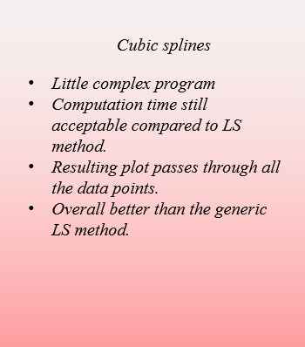
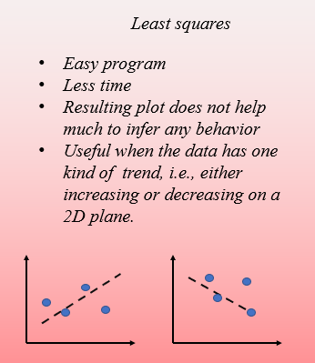
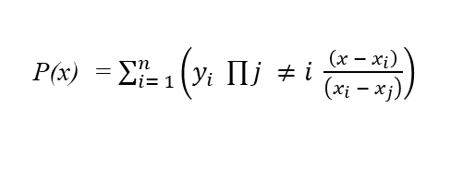
Conclusion
Lagrange method
P(x) = $\sum_{i= 1}^{n}{\left(y_{i} \prod{j ≠i} \frac{\left(x − x_{i}\right)}{\left(x_{i} − x_{j}\right)}\right)}$
MATLAB ends up with “NaN” for such huge sample data.
1/10 times, program would converge to a solution for some randomly picked 10 samples.
Better than Lagrange method as well
Stevens Institute of Technology

Slide 13

Thank you
Stevens Institute of Technology

